Slide 1
FOUR MAN SPECIAL TEAMS MECHANICS

Slide 2
KICK OFF
Referee – Kick Line, counts kicking team (45 Yard Line Bench Side)
Down Judge – Receiving Line (55 Yard Line Opposite Referee)
Line Judge - Position on sideline by deepest receiver same side as referee. Younger ages, Atom/Pee Wee move up to 55 opposite Down Judge
Umpire – Position on sideline by deepest receiver same side as Down Judge, counts return team.
HANDS UP WHEN READY

Slide 3
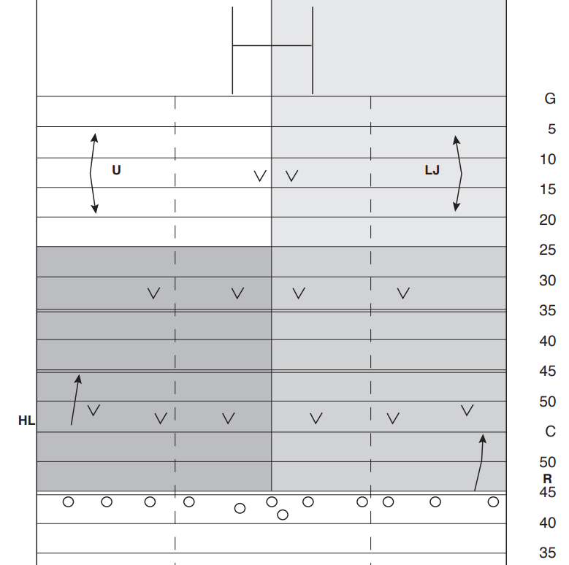

Slide 4
PUNT
Referee – Look for onside guy, Has kicker
Down Judge/Line Judge – Short Side has to return man. Note: On no yards just because the ball bounces doesn’t mean 5 yard penalty. The kicking team still has to make an effort to get out of restraining zone.
Umpire – Has Center and blocking, moves with the blocking

Slide 5
